Slide 1

Modeling leaf responses to soil nitrogen availability
Nick Smith (Texas Tech University; nick.smith@ttu.edu)
Evan Perkowski, Lizz Waring, Christy Goodale, Dave Frey, Qing Zhu, Bill Riley, Trevor Keenan

Slide 2
What aspects of this coupling should we be predicting with our models?
Evidence from experiments
Where we stand with models

Slide 3
What should models be able to reproduce?
Increased growth with increased soil N? √ - √
Decreased C cost to acquire N with increased soil N in whole plants √, maybe in leaves √
Increased tissue N with increased soil N √ √ √
Decreased relative leaf N allocation to photosynthesis with increased soil N √ √
Reduced N with elevated temperature and CO₂ √

Slide 4
What should models be able to reproduce?
Increased growth with increased soil N? √ - √
Decreased C cost to acquire N with increased soil N in whole plants √, maybe in leaves √
Increased tissue N with increased soil N √ √ √
Decreased relative leaf N allocation to photosynthesis with increased soil N √ √
Reduced N with elevated temperature and CO₂ √

Slide 5
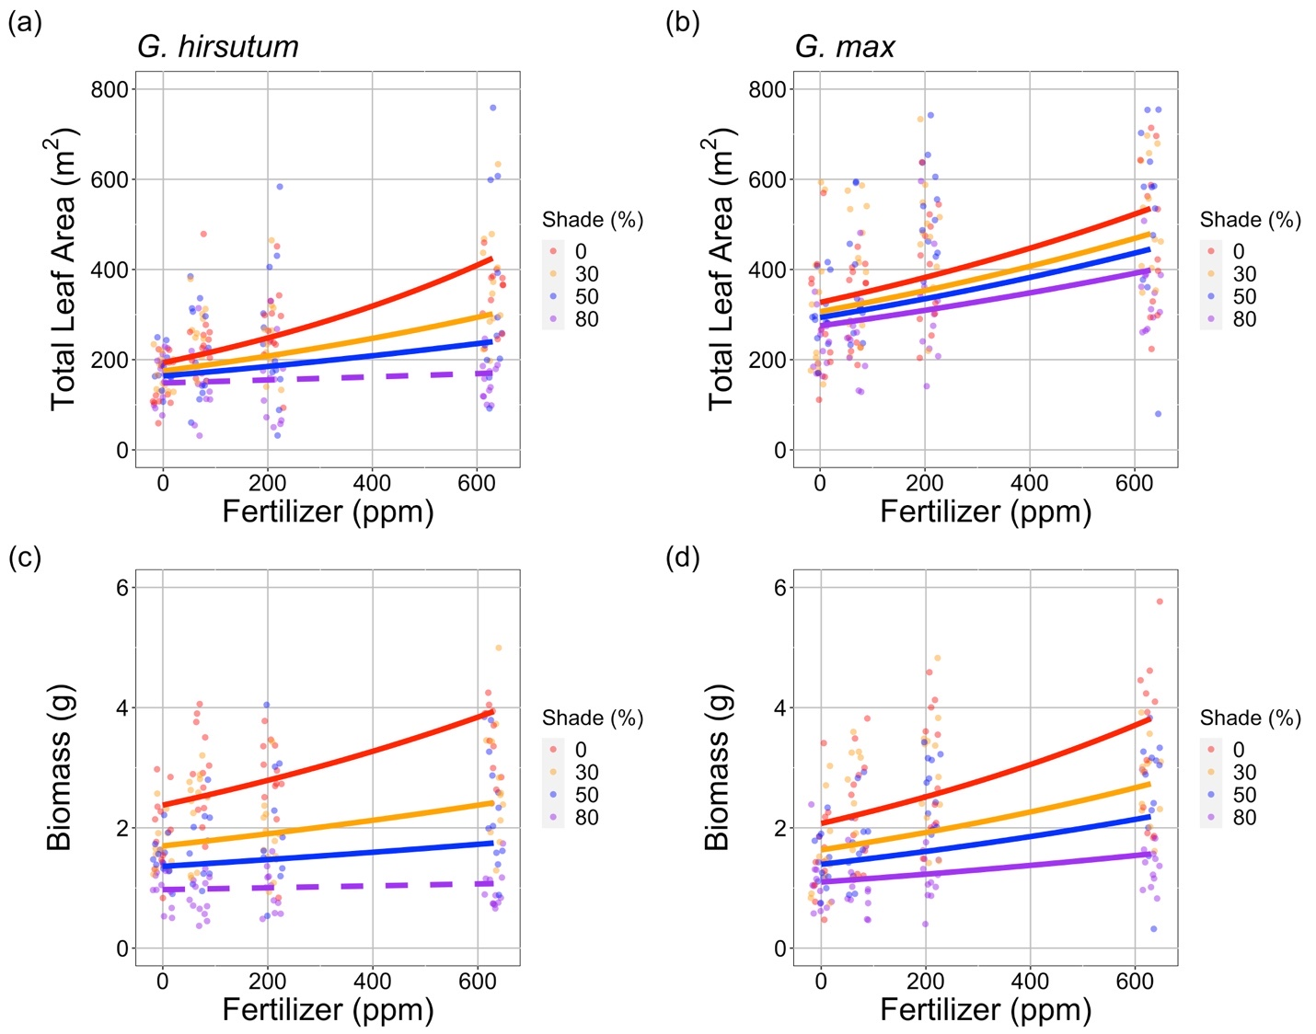
Growth increases with increasing soil N in greenhouse
Waring et al. (in prep)

Slide 6
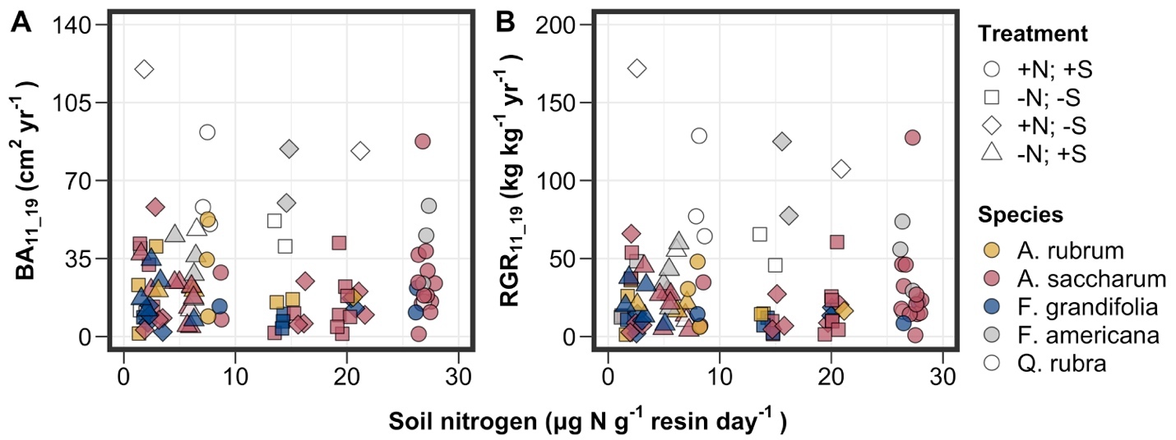
Growth unchanged with increasing soil N in closed canopy forest
Perkowski et al. (in prep)

Slide 7
What should models be able to reproduce?
Increased growth with increased soil N √ - √
Decreased C cost to acquire N with increased soil N in whole plants √, maybe in leaves √
Increased tissue N with increased soil N √ √ √
Decreased relative leaf N allocation to photosynthesis with increased soil N √ √
Reduced N with elevated temperature and CO₂ √

Slide 8
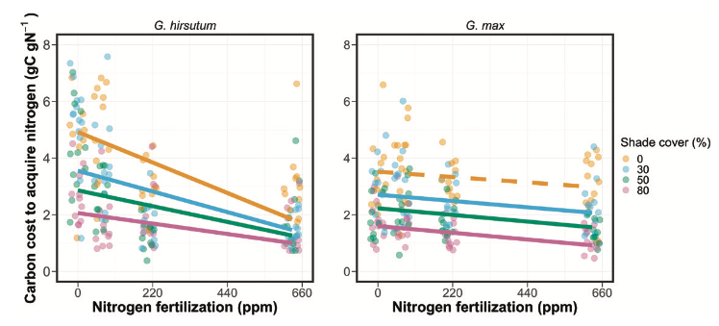
C cost to acquire N decreases with increasing soil N
Perkowski et al. (2021)

Slide 9
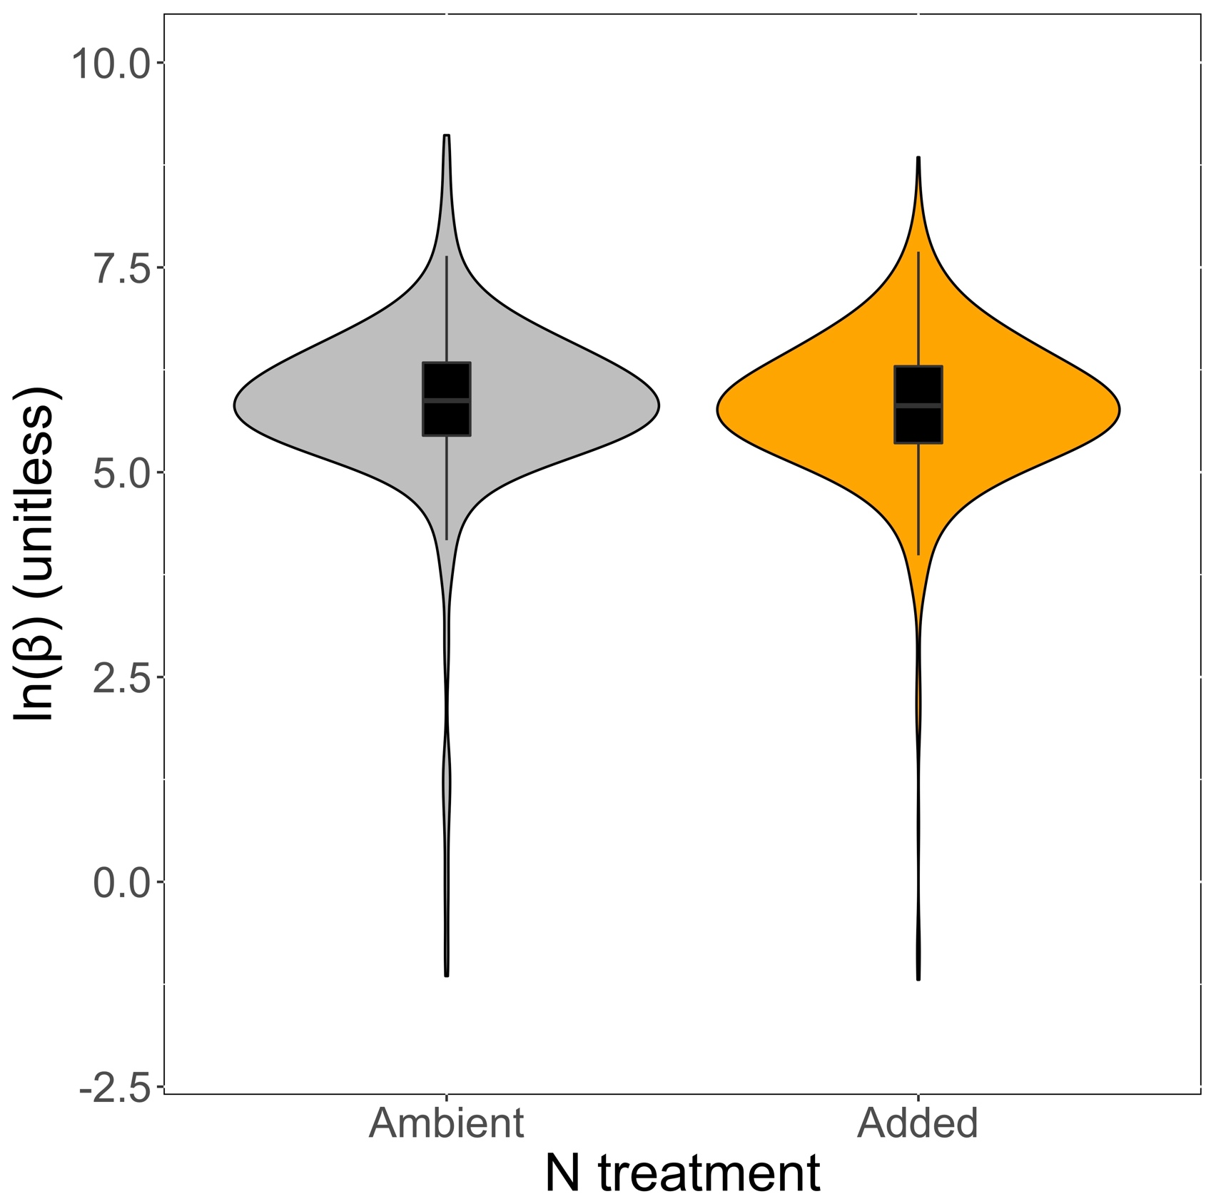
Reduction in relative N acquisition cost with increased N
Change is significant, but slight (-8%)
Smith et al. (in prep)

Slide 10
What should models be able to reproduce?
Increased growth with increased soil N √ - √
Decreased C cost to acquire N with increased soil N in whole plants √, maybe in leaves √
Increased tissue N with increased soil N √ √ √
Decreased relative leaf N allocation to photosynthesis with increased soil N √ √
Reduced N with elevated temperature and CO₂ √

Slide 11
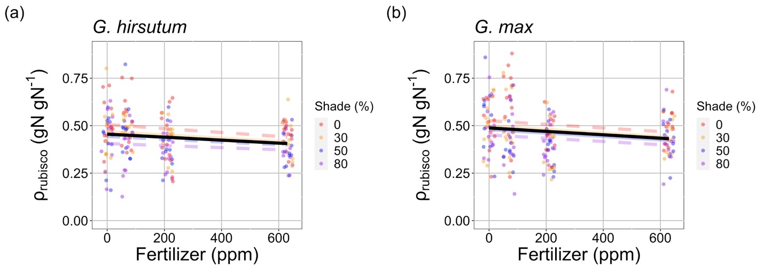
Relative leaf N allocation to photosynthesis decreases with increasing soil N
Consistent across all species, treatments, and photosynthetic components (Rubisco, bioenergetics, light harvesting)
Waring et al. (in prep)

Slide 12
What should models be able to reproduce?
Increased growth with increased soil N √ - √
Decreased C cost to acquire N with increased soil N in whole plants √, maybe in leaves √
Increased tissue N with increased soil N √ √ √
Decreased relative leaf N allocation to photosynthesis with increased soil N √ √
Reduced N with elevated temperature and CO₂ √

Slide 13
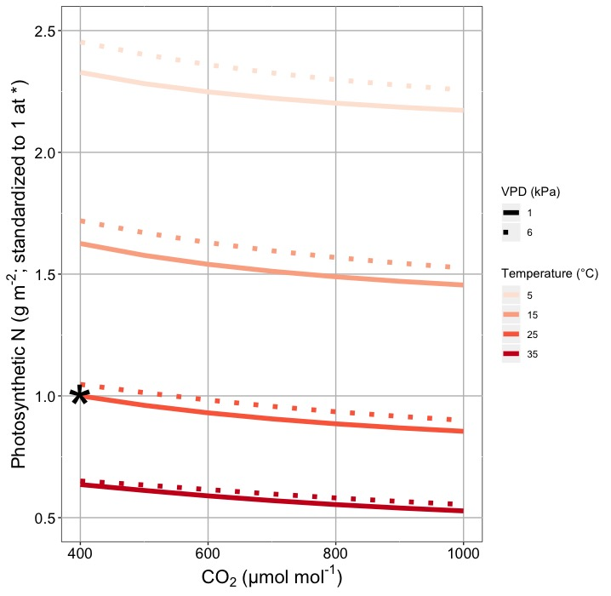
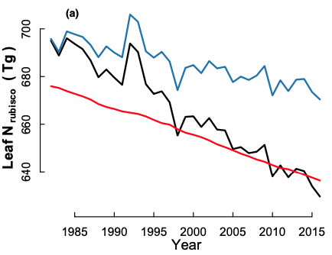
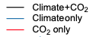
Elevated temperature and CO₂ reduce leaf photosynthetic N
Smith and Keenan (2020)
Dong et al. (2022)

Slide 14
What should models be able to reproduce?
Increased growth with increased soil N √ - √
Decreased C cost to acquire N with increased soil N √ √
Increased tissue N with increased soil N √ √ √
Decreased relative leaf N allocation to photosynthesis with increased soil N √ √
Reduced N with elevated temperature and CO₂ √

Slide 15
What do models attempt to reproduce?

Slide 16
What do models attempt to reproduce?
Increased growth with increased soil N √ - √
Decreased C cost to acquire N with increased soil N √ √
Increased tissue N with increased soil N √ √ √
Decreased relative leaf N allocation to photosynthesis with increased soil N √ √
Reduced N with elevated temperature and CO₂ √

Slide 17
What can models reproduce reliably from theory?

Slide 18
What can models reproduce reliably from theory?
Increased growth with increased soil N √ - √
Decreased C cost to acquire N with increased soil N √ √
Increased tissue N with increased soil N √ √ √
Decreased relative leaf N allocation to photosynthesis with increased soil N √ √
Reduced N with elevated temperature and CO₂ √

Slide 19

nick.smith@ttu.edu; @nick_greg_smith
Presentation available at:
www.github.com/SmithEcophysLab/mmee_2022
Thanks!

Slide 20
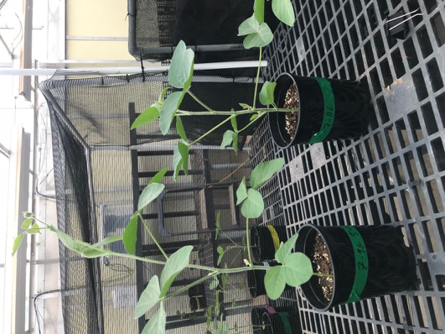
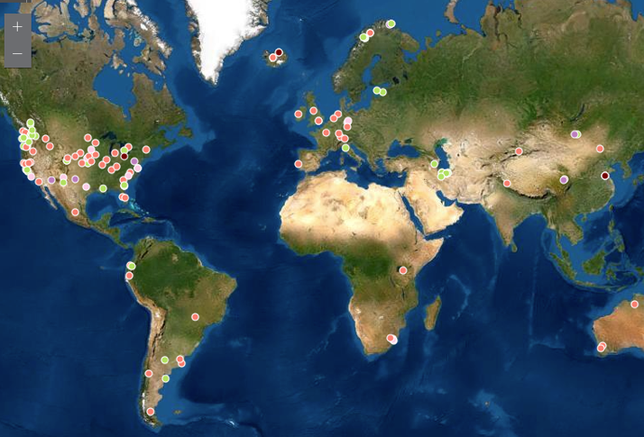
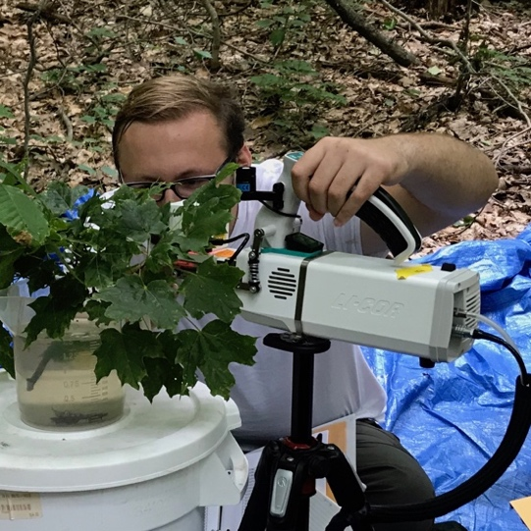
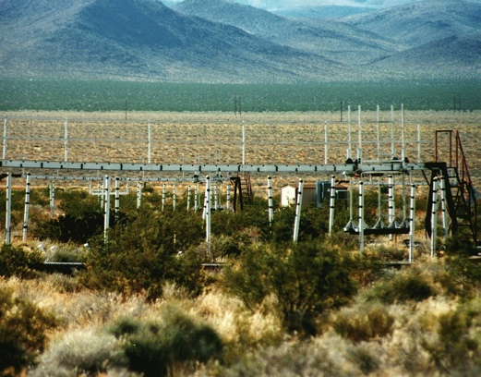
Soil nitrogen greenhouse
manipulation
Grassland soil nitrogen
manipulations
Forest soil nitrogen
manipulation
Temperature and CO₂
manipulations

Slide 21
Soil nitrogen greenhouse
manipulation
Grassland soil nitrogen
manipulations
Forest soil nitrogen
manipulation
Temperature and CO₂
manipulations

Slide 22
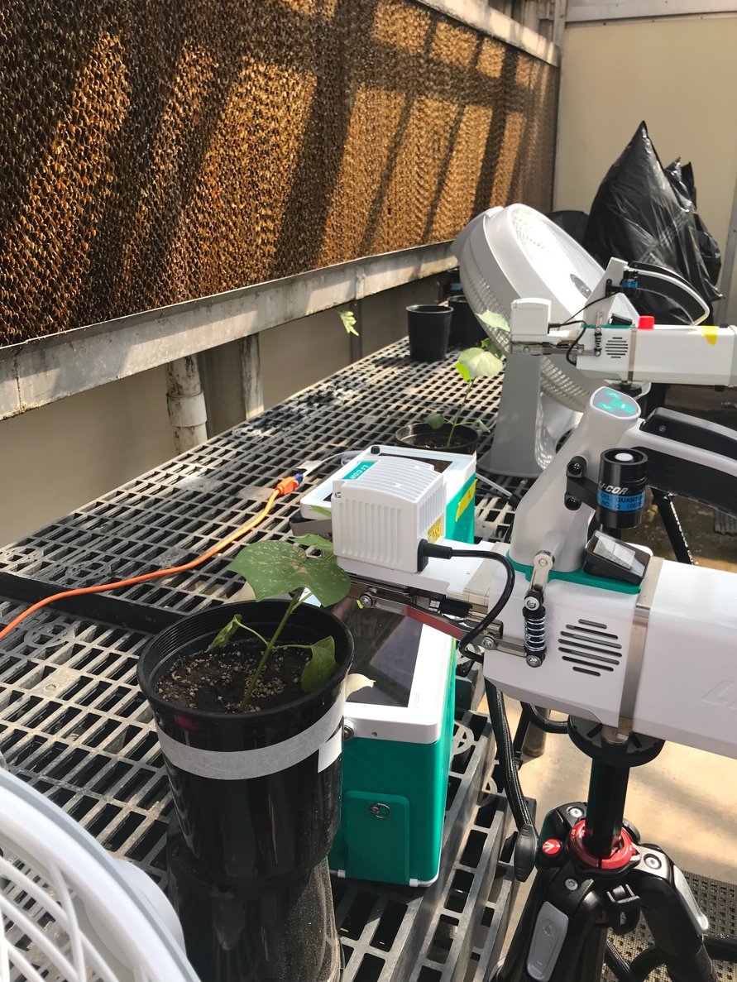
Soil N greenhouse manipulation
4 levels of nitrogen fertilization to low N field soil
0 ppm N – 630 ppm N added twice per week
4 levels of light availability
Full light (1662 µmol m⁻² s⁻¹ PAR) to 80% shade
2 species
Cotton (non-N fixing) and soybean (N fixing)
Full factorial
Physiology, allocation, and growth measured

Slide 23
Result: Growth increases with increasing soil N
Waring et al. (in prep)

Slide 24
Result: C cost to acquire N decreases with increasing soil N
Perkowski et al. (2021)

Slide 25
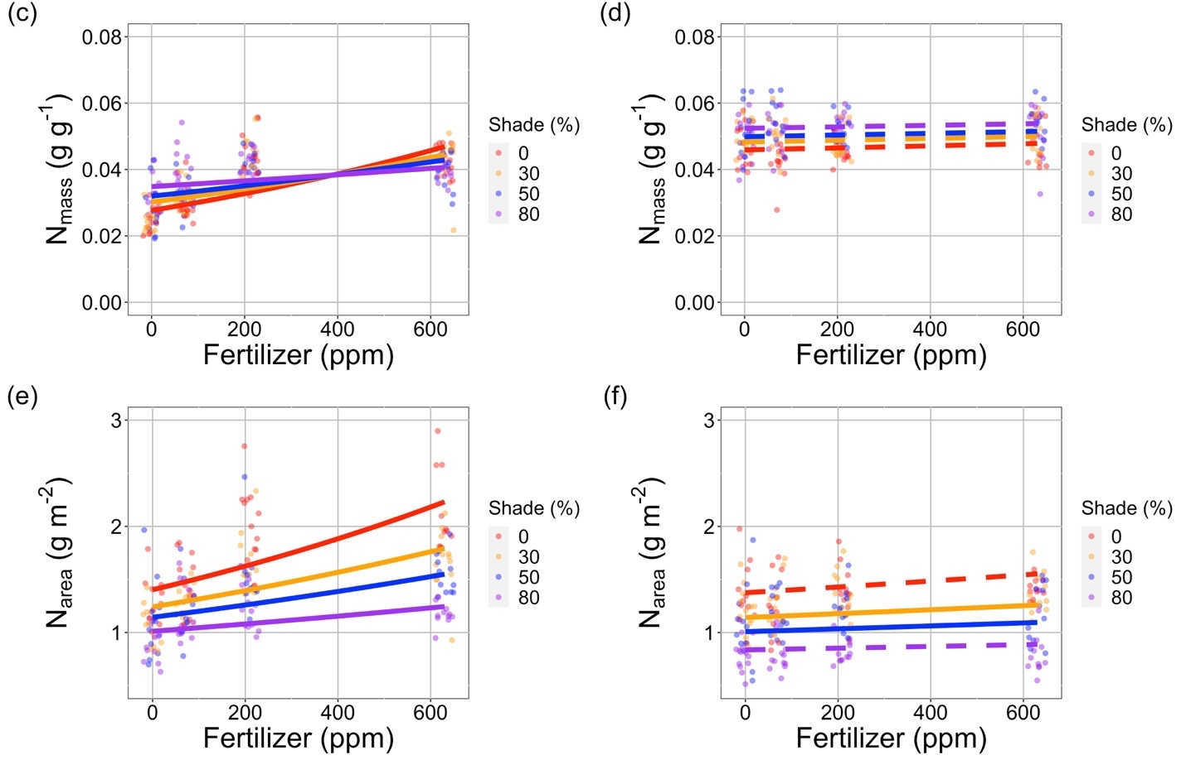
Result: Tissue N increases with increasing soil N
Waring et al. (in prep)

Slide 26
Result: Relative leaf N allocation to photosynthesis decreases with increasing soil N
Consistent across all species, treatments, and photosynthetic components (Rubisco, bioenergetics, light harvesting)
Waring et al. (in prep)

Slide 27
What should models be able to reproduce?
Increased growth with increased soil N √
Decreased C cost to acquire N with increased soil N √
Increased tissue N with increased soil N √
Decreased relative leaf N allocation to photosynthesis with increased soil N √

Slide 28
Soil nitrogen greenhouse
manipulation
Grassland soil nitrogen
manipulations
Forest soil nitrogen
manipulation
Temperature and CO₂
manipulations

Slide 29

Forest soil N manipulation
Closed canopy forest in Ithaca, NY
Various deciduous trees
2 levels of nitrogen fertilization
0 or 50 kg N ha⁻¹ yr⁻¹
2 levels of sulfur fertilization
0 or 50 kg S ha⁻¹ yr⁻¹
Full factorial
Physiology and growth measured

Slide 30
Result: Growth unchanged with increasing soil N
Perkowski et al. (in prep)

Slide 31
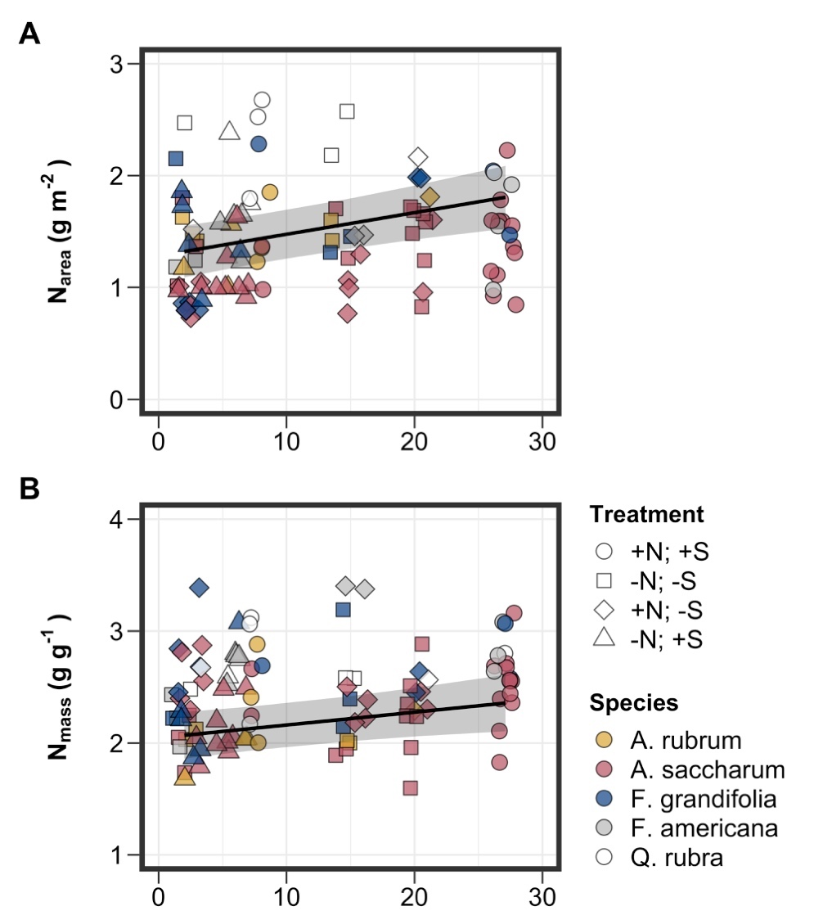
Result: Tissue N increases with increasing soil N
Perkowski et al. (in prep)

Slide 32
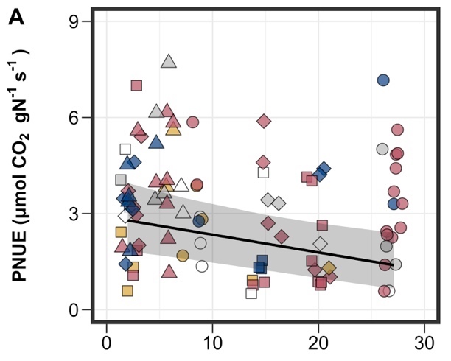
Result: Relative leaf N allocation to photosynthesis decreases with increasing soil N
Waring et al. (in prep)

Slide 33
What should models be able to reproduce?
Increased growth with increased soil N √ -
Decreased C cost to acquire N with increased soil N √
Increased tissue N with increased soil N √ √
Decreased relative leaf N allocation to photosynthesis with increased soil N √ √

Slide 34
Soil nitrogen greenhouse
manipulation
Grassland soil nitrogen
manipulations
Forest soil nitrogen
manipulation
Temperature and CO₂
manipulations

Slide 35
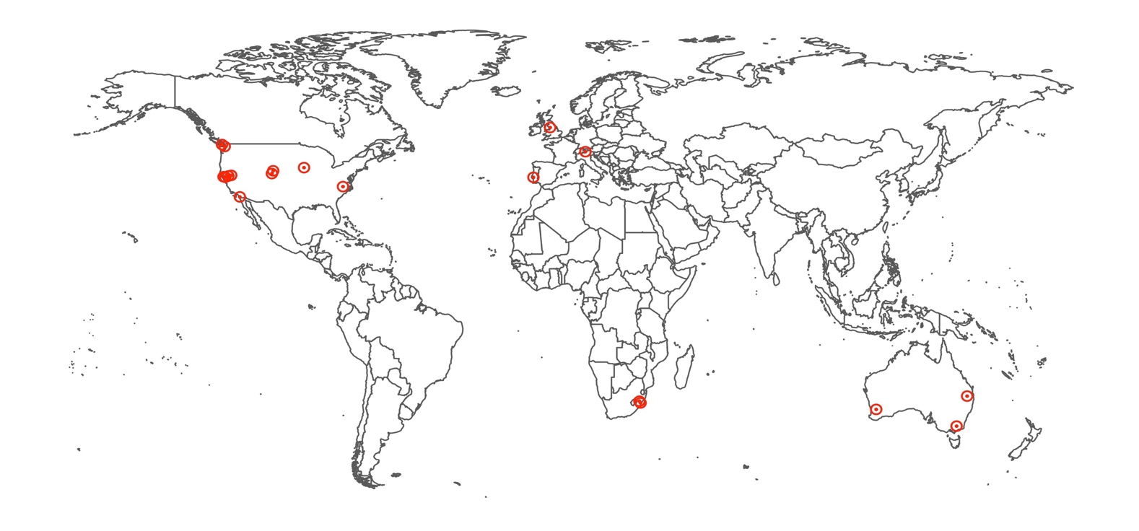
Global grassland soil N manipulations
Nutrient Network
Global grassland factorial N+P+K addition
Leaf trait dataset
19 sites
2129 individuals
208 species
Leaf N and δ¹³C
δ¹³C used to compute ratio of intercellular to extracellular CO₂ and carbon cost ratio of soil resource uptake

Slide 36
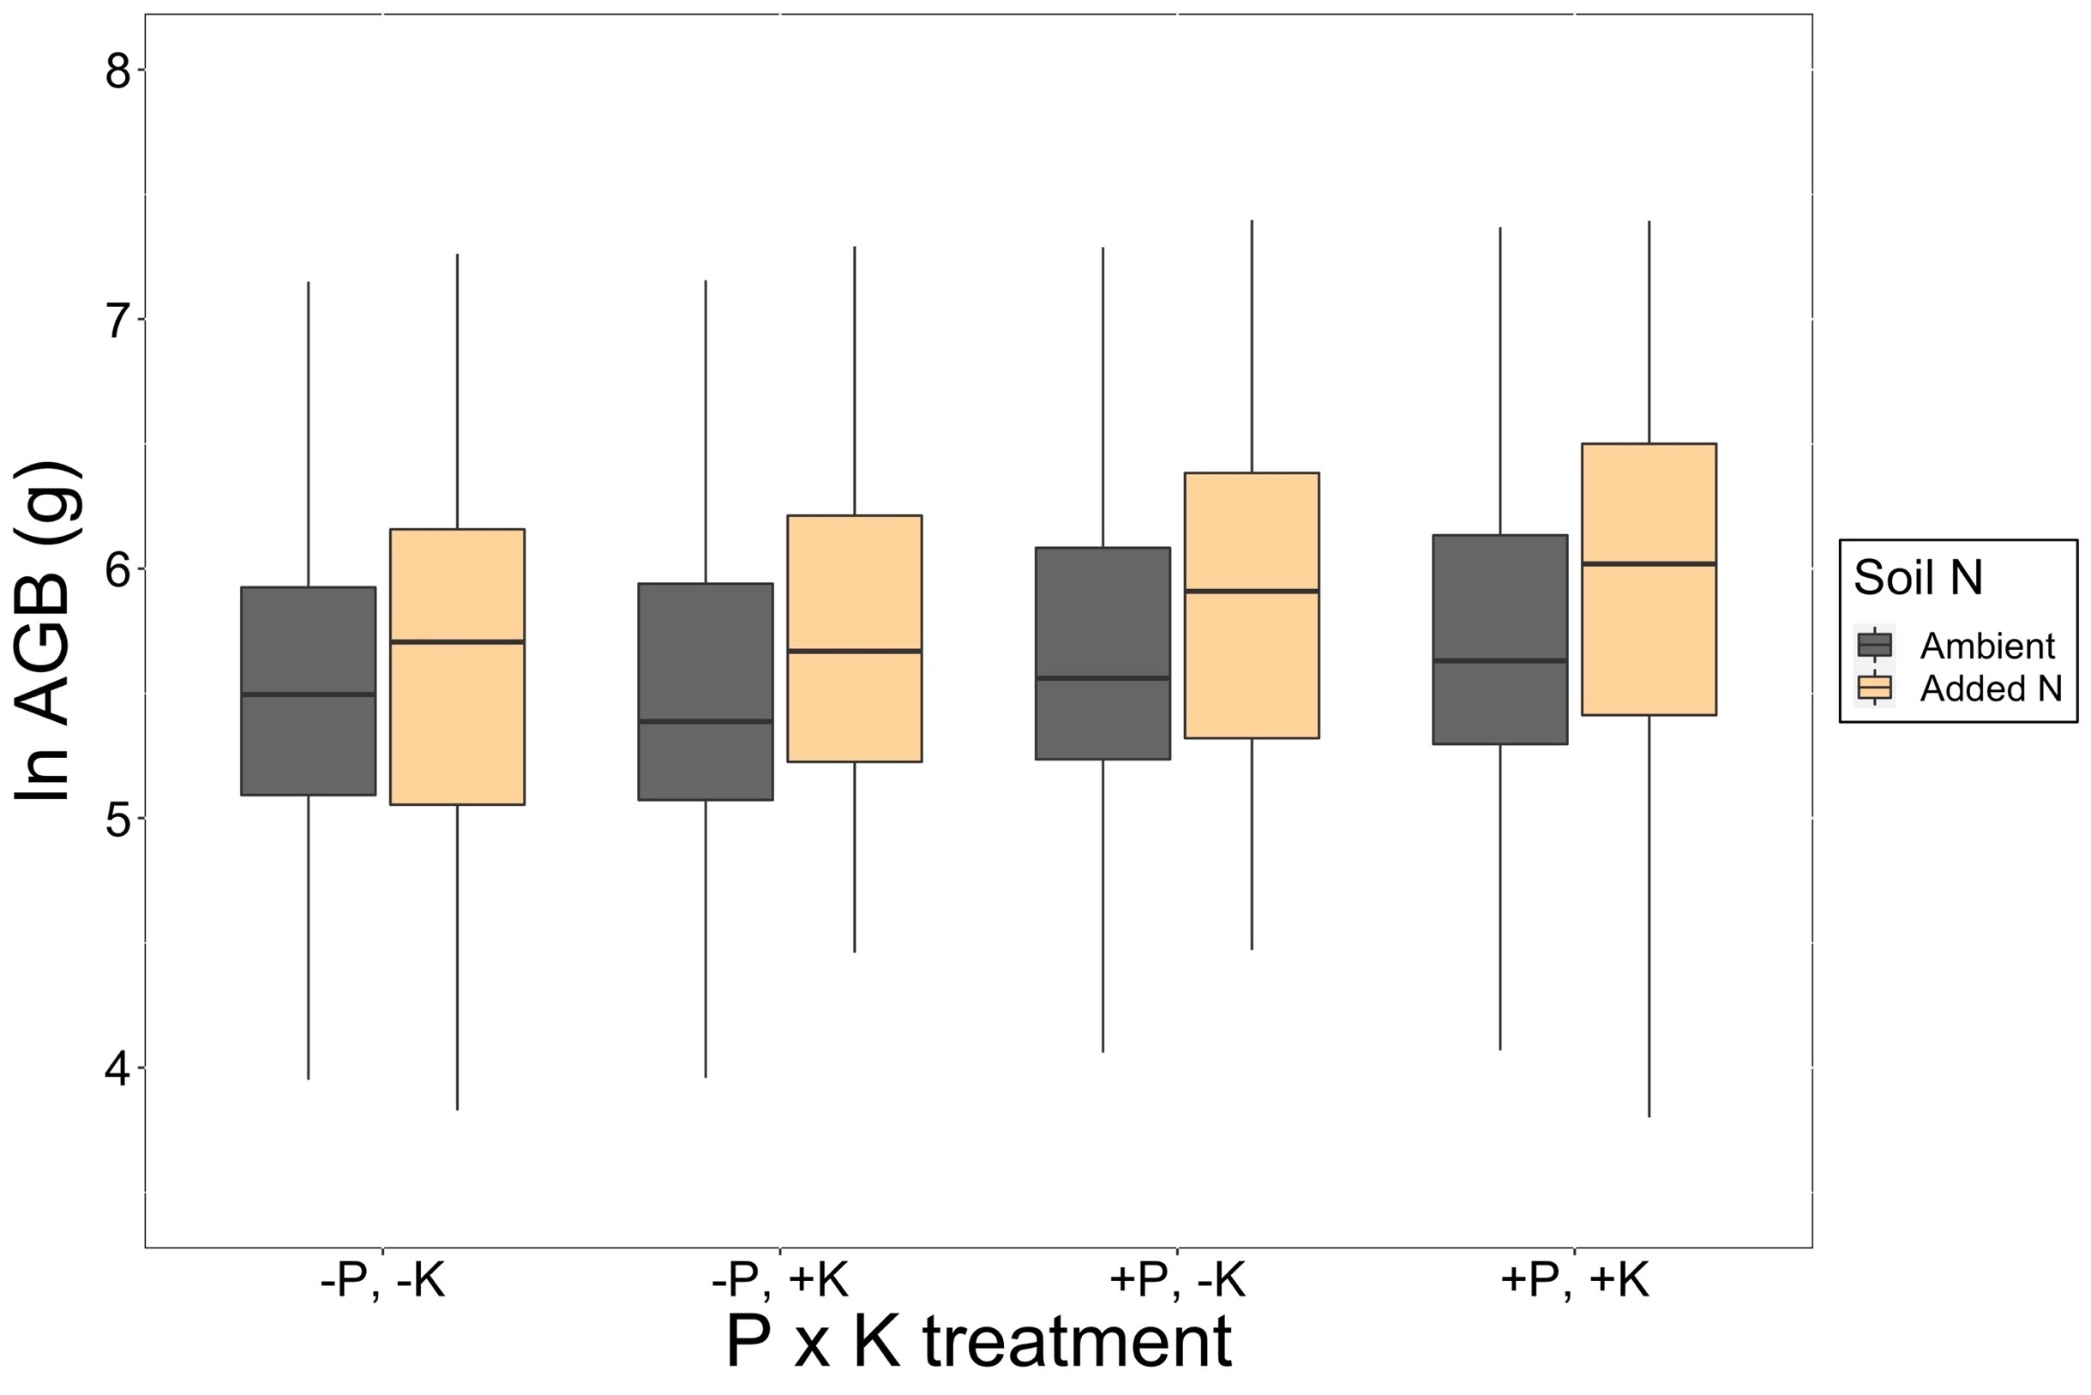
Result: Growth increases with increasing soil N
Always increases regardless of P and K
Smith et al. (in prep)

Slide 37
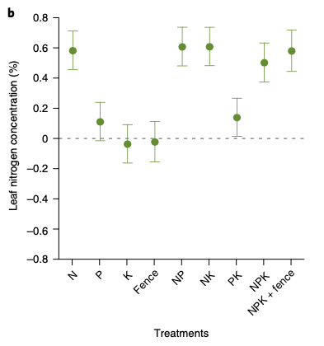
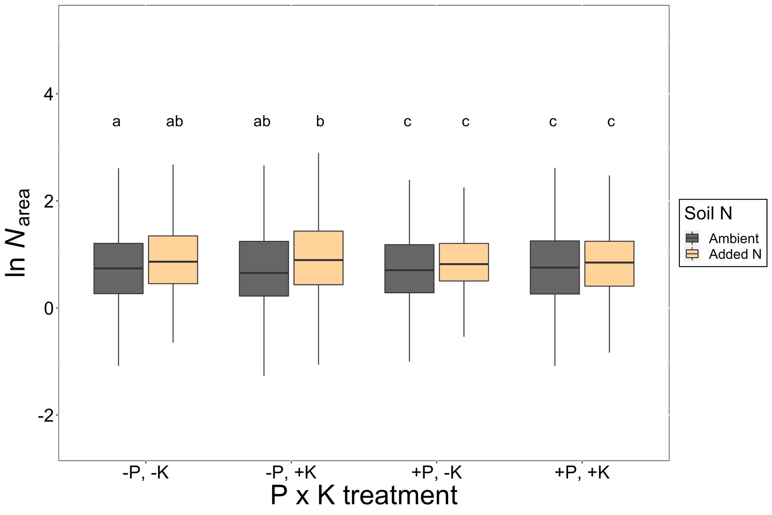
Result: Tissue N increases with increasing soil N
Firn et al. (2019)
Smith et al. (in prep)

Slide 38
Result: Reduction in relative N acquisition cost with increased N
Change is significant, but slight (-8%)
Smith et al. (in prep)

Slide 39
What should models be able to reproduce?
Increased growth with increased soil N √ - √
Decreased C cost to acquire N with increased soil N √ √
Increased tissue N with increased soil N √ √ √
Decreased relative leaf N allocation to photosynthesis with increased soil N √ √

Slide 40
Soil nitrogen greenhouse
manipulation
Grassland soil nitrogen
manipulations
Forest soil nitrogen
manipulation
Temperature and CO₂
manipulations

Slide 41
Temperature and CO₂ manipulations
Model-data testing
2 temperature manipulation experiments
31 elevated CO₂ experiments
Leaf model simulations
Canopy model simulations

Slide 42
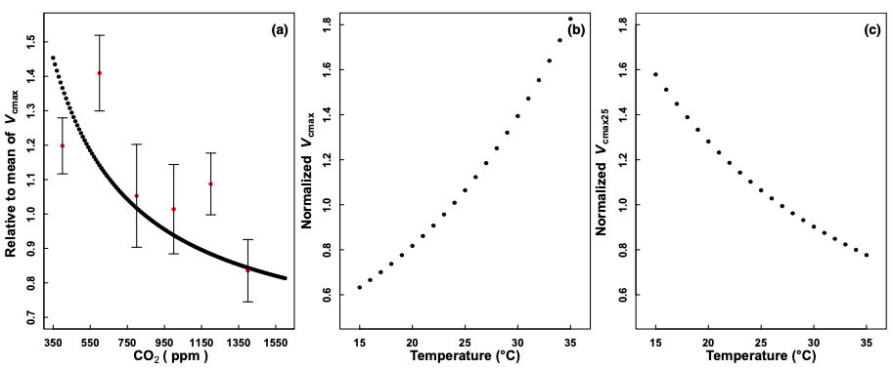
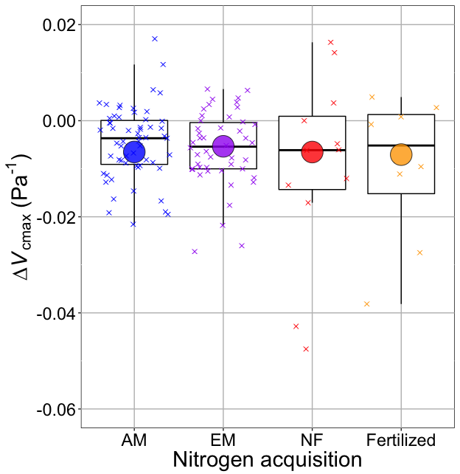
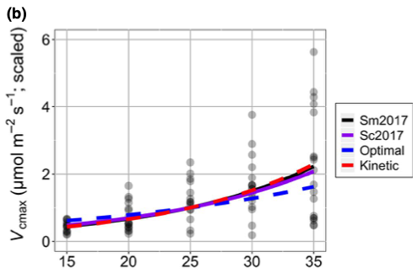
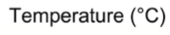
Result: elevated temperature and CO₂ reduce leaf investment in photosynthetic biochemistry
Smith and Keenan (2020)
Dong et al. (2022)

Slide 43
Result: elevated temperature and CO₂ reduce leaf photosynthetic N
Smith and Keenan (2020)
Dong et al. (2022)

Slide 44
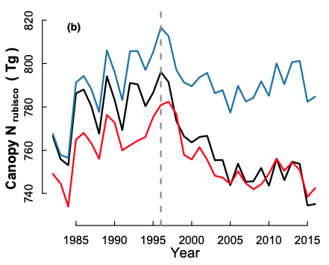
Result: elevated temperature and CO₂ reduce canopy N
Dong et al. (2022)

Slide 45
What should models be able to reproduce?
Increased growth with increased soil N √ - √
Decreased C cost to acquire N with increased soil N √ √
Increased tissue N with increased soil N √ √ √
Decreased relative leaf N allocation to photosynthesis with increased soil N √ √
Reduced N with elevated temperature and CO₂ √

Slide 46
Effect of soil N addition in CLM 5
GPP
Wieder et al. (2019)

Slide 47
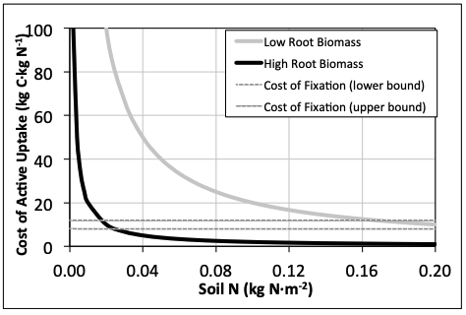
Effect of soil N on C cost of N uptake in FUN model
Fisher et al. (2010)

Slide 48
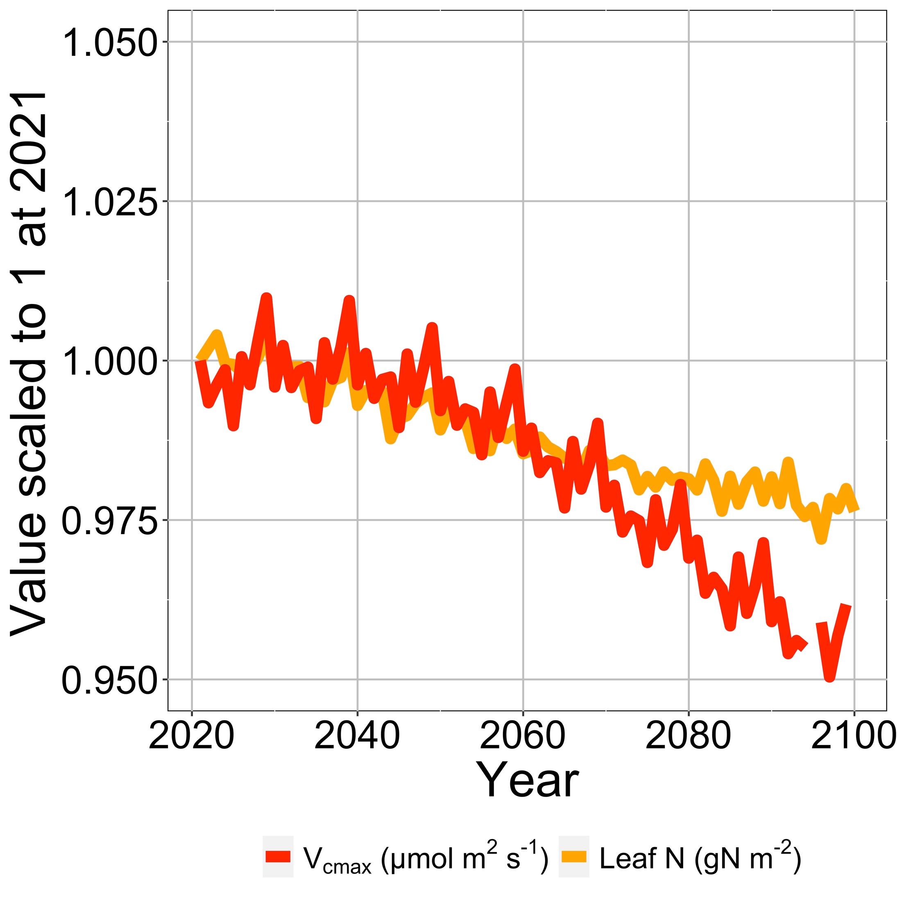
Reduced future allocation to photosynthesis and leaf N in an ELM simulation modified with EEO photosynthesis
Smith et al. (in prep)

